Slide 1
Introduction to Data Mining and Machine Learning
Redwan Ahmed Rizvee
https:/rizveeredwan.github.io/
YouTube Lecture Link

Slide 2
Database Applications: Transaction Processing vs. Decision Support
1. Transaction-Processing Systems (TPS)
Purpose: Record detailed information about transactions (e.g., sales, registrations, grades).
Characteristics: Widely used, accumulate vast amounts of detailed data (gigabytes to terabytes).
Examples: Product sales data, course registration, customer and transaction information (items purchased, price, date, customer details).
2. Decision-Support Systems (DSS)
Purpose: Extract high-level insights from TPS data to aid decision-making.
Goal: Help managers make strategic decisions (e.g., product stocking, manufacturing, university admissions, marketing strategies).
Example Applications:
Identifying sales trends (e.g., flannel shirts in Pacific Northwest). => Time series analysis
Targeting marketing based on customer demographics (e.g., small sports cars for young women with specific income). => Data Mining, Machine Learning
Challenge: Storing and retrieving data for decision support presents several issues.

Slide 3
Challenges and Solutions in Decision Support
SQL Limitations:
Many DSS queries are complex or cannot be easily expressed in standard SQL.
Solution: SQL extensions for data analysis (e.g., OLAP techniques).
Statistical Analysis:
Database query languages are not ideal for detailed statistical analysis.
Solution: Interfacing databases with specialized statistical packages (e.g., SAS, S++).
Diverse Data Sources:
Large companies have data from multiple sources with different schemas, often not easily retrievable on demand due to performance/control issues.
Solution: Data Warehouses – consolidate data from multiple sources into a unified schema at a single site, providing a uniform interface.
Knowledge Discovery & Pattern Recognition:
Need to automatically discover statistical rules and patterns from data.
Solution: Data Mining – combines AI and statistical techniques with efficient implementations for large databases to identify patterns in customer behavior and other data.

Slide 4
Data Warehousing: Addressing Data Challenges
1. Challenges with Diverse Data Sources for Decision Making
Geographical Distribution: Data spread across many stores (e.g., retail chains) or branches (e.g., insurance companies).
Organizational Complexity: Different data types (e.g., manufacturing problems, customer complaints) stored in various locations, operational systems, or under different schemas within a large organization.
External Data Integration: Need to incorporate data purchased from outside sources (e.g., mailing lists, credit scores).
Cumbersome Querying: Setting up queries across individual, disparate sources is inefficient and difficult.
Historical Data Access: Operational systems often store only current data, but decision-makers require access to past data (e.g., changes in purchase patterns over time).

Slide 5
2. Data Warehouses: The Solution
Definition: A data warehouse is a centralized repository (archive) of information.
Key Characteristics:
Multiple Sources: Gathers data from diverse internal and external sources.
Unified Schema: Stores all collected data under a single, consistent schema.
Single Site: Consolidates data at one location.
Historical Data: Data is stored for a long time, enabling access to historical trends and past information.
3. Benefits of Data Warehouses
Consolidated Interface: Provides users with a single, uniform interface to all data, simplifying decision-support queries.
Improved Efficiency: Makes it easier and more efficient to write complex decision-support queries.
Reduced Impact on TPS: Separates decision-support workloads from online transaction-processing systems, ensuring TPS performance is not affected.

Slide 6
Key Issues & ETL Tasks in Building a Data Warehouse
When and How to Gather Data:
Source-Driven: Sources transmit new data.
Destination-Driven: Warehouse requests new data.
Consistency: Typically slightly out-of-date (acceptable for DSS).
What Schema to Use:
Challenge: Different schemas/data models at sources.
Solution: Schema integration; data is a materialized view of sources.
Data Transformation and Cleansing:
Cleansing: Correcting inconsistencies (e.g., misspelled names/addresses, deduplication, householding).
Transformation: Changing units, converting schemas.
Tools: Graphical tools often support data flow specification.
How to Propagate Updates:
Challenge: Reflecting source updates in the warehouse.
Solution: View-maintenance problem.
What Data to Summarize:
Challenge: Raw data can be too large.
Solution: Maintain summary data (aggregations) for efficient querying.
ETL Tasks (Extract, Transform, Load):
Extract: Getting data from sources.
Transform: Cleansing and transforming data.
Load: Loading processed data into the warehouse.
The challenge of View Maintenance over the collected data from different sources

Slide 7
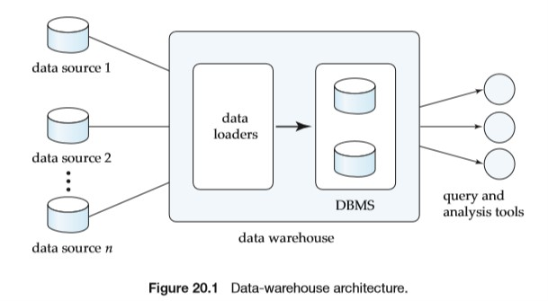
Data Warehouse Architecture

Slide 8
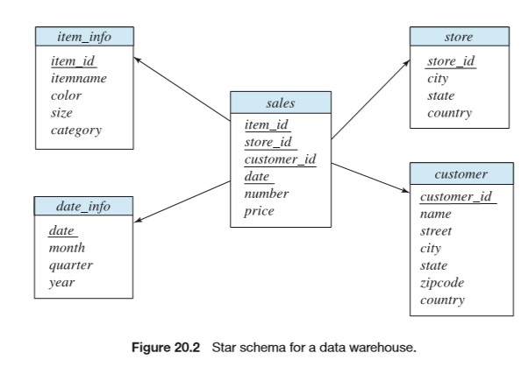
Schema Design for Data Warehouse
Dimension Tables & Attributes
Fact Tables

Slide 9
Designed for Data Analysis
Data warehouse schemas are optimized for analysis, often with OLAP tools, using multidimensional data with dimension and measure attributes.
Fact Tables
Fact tables store multidimensional data, are typically very large, and contain measure attributes (quantitative values like items sold, price) that can be aggregated. Example: A sales table with one tuple per item sold.
Dimension Attributes
Dimension attributes provide context for measures and are typically short identifiers serving as foreign keys. For a sales table, examples include Item ID, Date, Store ID, and Customer ID.
Dimension Tables
Dimension tables hold detailed information for each dimension attribute, minimizing fact table storage. Fact tables link to them via foreign keys.

Slide 10
Column-Oriented Storage
Row-Oriented Storage (Traditional): Stores all attributes of a tuple together, sequentially in a file.
Column-Oriented Storage (Contrast): Stores each attribute of a relation in a separate file; values from successive tuples are stored at successive positions.
Benefits of Column-Oriented Storage:
Efficient Querying: When a query needs only a few attributes, only those relevant attributes are fetched, saving memory and cache space.
Improved Compression: Storing similar data types together enhances compression effectiveness, reducing disk storage and retrieval time.
Drawbacks:
Fetching or storing a single tuple requires multiple I/O operations.
Application in Data Warehousing:
Not widely used for transaction-processing (due to single-tuple I/O drawback).
Gaining acceptance for data warehousing: Ideal for applications that involve scanning and aggregating multiple tuples (common in DSS queries), rather than accessing individual tuples.
Demonstrates significant performance gains for many data-warehousing applications.

Slide 11
Data Mining

Slide 12
Data Mining
Definition: The semiautomatic process of analyzing large databases to find useful patterns, often referred to as "knowledge discovery in databases."
Distinction: Differs from machine learning and statistics by focusing on large volumes of data primarily stored on disk.
Process: Typically involves a semi automatic approach, including manual preprocessing of data and post-processing of discovered patterns to identify useful ones.
Feedback
AI
Data Mining
reasoning, learning, problem-solving, perception, and decision-making
discovering patterns, insights, and knowledge from large datasets.
uses
Machine Learning
uses
allow computers to learn from data and make predictions or decisions without being explicitly programmed for every scenario

Slide 13
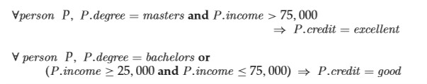
Classification (A Type of Data Mining Prediction)
Problem: Given items belonging to several known classes and past training instances, predict the class a new item belongs to, using its other attributes.
Method: Often involves finding rules that partition data into disjoint groups.
Example (Credit Card Application):
A company wants to predict an applicant's credit-worthiness (excellent, good, average, bad).
It uses existing customer data (training set) with known creditworthiness based on payment history.
Rules are derived from attributes like education level and income (e.g., "P.degree = masters and P.income > 75,000 P.credit = excellent").
These rules are then applied to new applicants whose payment history is unknown.

Slide 14
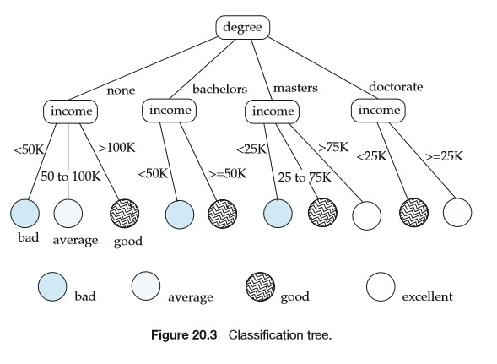
Decision Tree Classifier:

Slide 15
Building Decision-Tree Classifiers
Method: Most commonly built using a greedy, recursive algorithm that starts at the root and builds the tree downward.
Initial State: All training instances are associated with the root node.
Node Processing:
If "almost all" training instances at a node belong to the same class, the node becomes a leaf node associated with that class.
Otherwise, a partitioning attribute and partitioning conditions are selected to create child nodes.
Data associated with each child node consists of instances satisfying its partitioning condition.
Example (Credit Card Application):
First Split: Attribute degree is chosen, creating four child nodes (e.g., degree = none, degree = bachelors, degree = masters, degree = doctorate).
Second Split (under degree = masters): Attribute income is chosen, with ranges like "0 to 25K," "25K to 50K," "50K to 75K," and "over 75K."
Optimization: If multiple ranges lead to the same class, they can be merged (e.g., "25K to 75K" for the "good" credit class).

Slide 16
Best Splits for Decision Trees
Goal: To measure the "purity" of data at nodes and select the attribute and condition that result in the maximum purity at the children.
Purity Measures:
Gini Measure: Gini(S)=1−∑_{i=1}^{k}​p_{i}²​ (where p_{i} is the fraction of instances in class i). Gini is 0 for a single class and maximum when classes are equally distributed.
Entropy Measure: Entropy(S)=−∑_{i=1}^{k}​p_{i}​log₂​(p_{i}​). Entropy is 0 for a single class and maximum when classes are equally distributed.

Slide 17
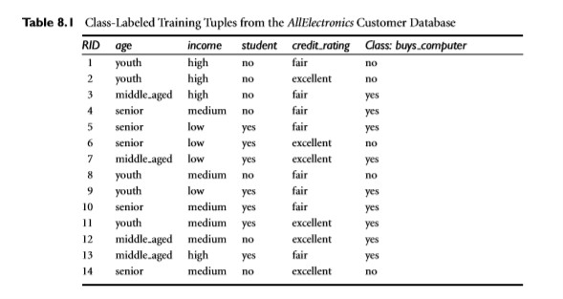
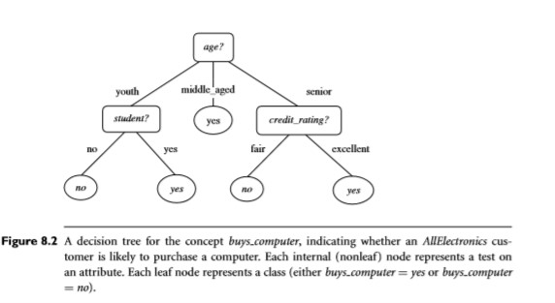
Gini(S) = 1 - (9/14)² - (5/14)² = 0.46
Entropy (S) = - (9/14) * log(9/14) - (5/14) * log(5/14) = 0.93

Slide 18

Purity of Resultant Sets: For a split of set S into S_{1​},S₂​,…,S_{r}​: Purity(S_{1​},S₂​,…,S_{r}​)=∑_{i=1}^{r}​(∣S_{i​}∣/∣S∣) ​x purity(S_{i​}) (weighted average).
Information Gain: Measures the reduction in entropy (or Gini impurity) after a split: Information.gain (S,{S_{1​},S₂​,…,S_{r}​}) = purity(S) − purity(S_{1​},S₂​,…,S_{r}​​)
Information Content of a Split: Defined in terms of entropy: Information.content(S,{S_{1​},S₂​,…,S_{r}​})=−∑_{i=1}^{r}​ (∣S_{i}​∣ / ∣S∣ ) ​log₂​(∣S_{i}​∣ / ∣S∣)
Best Split Criterion: The best split for an attribute is the one that gives the maximum information gain ratio, defined as:
Preference for Fewer Splits: Splits into fewer sets are generally preferred for simpler and more meaningful decision trees.

Slide 19
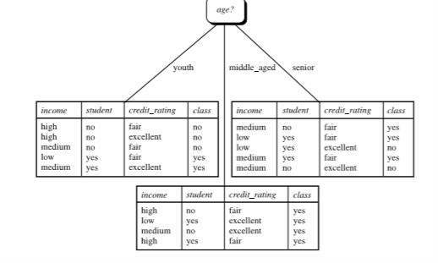
P(youth) = -(⅖) log₂ (⅖) - (⅗ ) log₂ (⅗ ) = 0.97096
P(senior) = -(⅗ ) log₂ (⅗ ) - (⅖ ) log₂ (⅖ ) = 0.97096
Purity of Resultant Sets
= 5/14 * P(youth) + 5/14 * P(senior) + 4/14 * P(middle_aged) = (5/14) * 2 * 0.97096 = 0.694
P(middle_aged) = 0
Information Gain = 0.93 - 0.694 = 0.236
Information Content = -5/14 * log₂(5/14) - 5/14 * log₂(5/14) - 0 = 1.061
Gain Ratio = 0.236/1.061 = 0.22

Slide 20
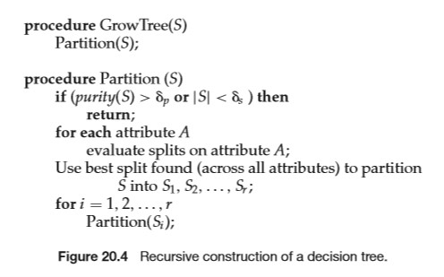
Decision-Tree Construction Algorithm
Several of the algorithms also prune subtrees of the generated decision tree to reduce overﬁtting: A subtree is overﬁtted if it has been so highly tuned to the speciﬁcs of the training data that it makes many classiﬁcation errors on other data

Slide 21
Association Rules
Definition: Rules that describe relationships between items in large databases, often in the form i₁​,i₂​,…,i_{n}​⇒i₀​. Left side Antecedent, Right Side Precedent.
Key Measures for Association Rules:
Support:
A measure of what fraction of the population satisfies both the antecedent (items on the left side of ) and the consequent (item on the right side of ⇒) of the rule.
Indicates how frequently the itemset (antecedent + consequent) appears in the dataset.
Example: If 0.001% of all purchases include milk and screwdrivers, the support for milk ⇒ screwdrivers is low. Rules with low support are often not statistically significant or interesting.
Confidence:
A measure of how often the consequent is true when the antecedent is true.
Indicates the reliability of the rule.
Example: If bread ⇒ milk has a confidence of 80%, it means that in 80% of purchases where bread is bought, milk is also bought. High confidence (ideally close to 100% in business applications) is desirable.

Slide 22
Large Itemsets
Definition: Sets of items that occur together with sufficient "support" (i.e., frequently enough) in the database.
Purpose: Rules with high confidence are generated only from large itemsets.
Apriori Technique for Generating Large Itemsets
Approach: A greedy algorithm that works in multiple passes over the data.
Pass 1: Counts only single items. Sets with insufficient support are eliminated.
Subsequent Passes (e.g., Pass 2): Considers sets with two items, and so on.
Optimization: At the end of each pass, any set with insufficient support is eliminated, and none of its supersets need to be considered in further passes (because if a set is not frequent, any set containing it also cannot be frequent).
Termination: Computation terminates when no set of a given size has sufficient support, meaning no larger sets can be frequent.

